Slide 1
The Elements of Culture

Slide 2
The Seven Elements of Culture
The Seven Elements of Culture are:
Social Organization
Language
Customs and Traditions
Religion
Arts and Literature
Forms of Government
Economic Systems

Slide 3
Social Organization
The family forms the foundation of social organization for each society.
Families can be categorized in two ways:
Nuclear – traditionally a man, his wife, and their children
Extended – this includes grandparents, aunts and uncles, and cousins
In the western world, the nuclear family lives under the same roof. In other cultures the extended family may live with them as well.
Families teach their children the values of a culture, expectations for behavior, language, and much more.

Slide 4
Social Organization
Societies are also commonly organized into classes.
Classes can be based on wealth (upper, middle, lower), occupation, or ancestry.
In some cultures it is possible to move between these class levels due to education level, wealth, or other factors. This is called social mobility.
Some societies, however, strictly enforce these class levels and keep people in their current class for their entire life. An example of this rigid class system would be the caste system of India.

Slide 5
Social Organization
The person who exercises authority, or power, in a family varies from one culture to another.
Most cultures are patriarchal, or cultures where the male holds power.
Women hold authority in matriarchal societies.
Marriage customs can also vary.
Commonly marriages are monogamous (monogamy), or where an individual has only one partner during their lifetime or at any one time.
Polygamy is where there are multiple spouses to one person.
Polygyny – One husband and multiple wives
Polyandry – One wife and multiple husbands
Some marriages can be arranged, or predetermined by the parents of the bride and groom.
Arranged marriages are often created for economic or political reasons.
Typically the parents of the bride pay bride wealth (dowry) to the family of the groom in order to offset the cost of providing for the woman.

Slide 6
Language
Language is the cornerstone of culture.
It is how we communicate our ideas to one another.
All cultures have a spoken language (but not necessarily a written one.)
People who speak the same language tend to share the same culture.
A dialect is a form of a language that differs from place to place.
Different languages can be spoken within the same society.

Slide 7
Language
What do you call the miniature lobster that one finds in lakes or streams?
How do you pronounce “crayon”?
Do you call coleslaw “slaw”?
What word(s) do you use to address a group of two or more people?
How do you pronounce the second vowel in “pajamas”?
How do you pronounce “pecan”?
What is your generic term for a sweetened carbonated beverage?
What do you call a traffic situation in which several roads meet in a circle and you have to get off at a certain point?
What do you call a long sandwich that contains cold cuts, lettuce, etc.?
What do you call the thing from which you might drink water in a school?
What is your “general” term for rubber-soled shoes worn in gym class for athletic activities?

Slide 9
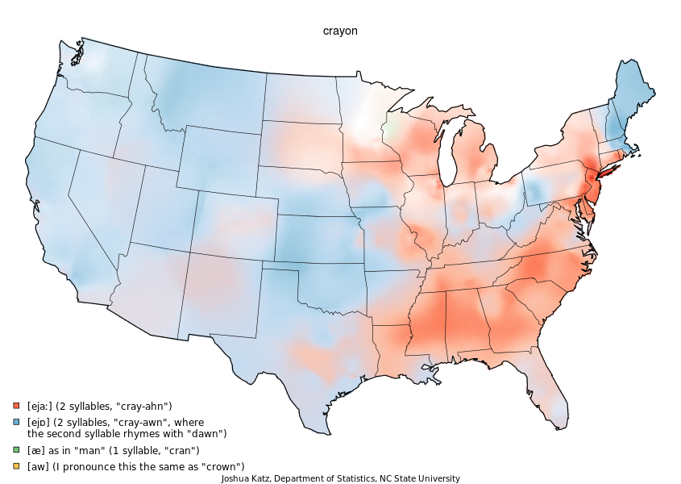

Slide 10
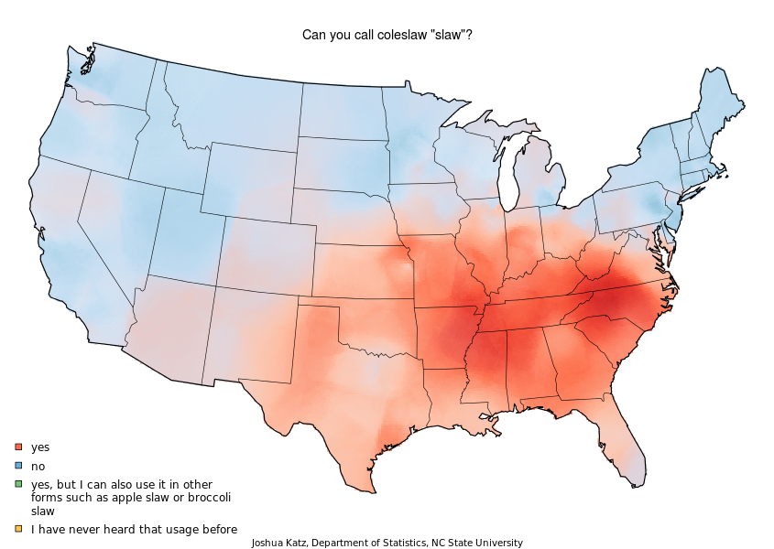

Slide 12
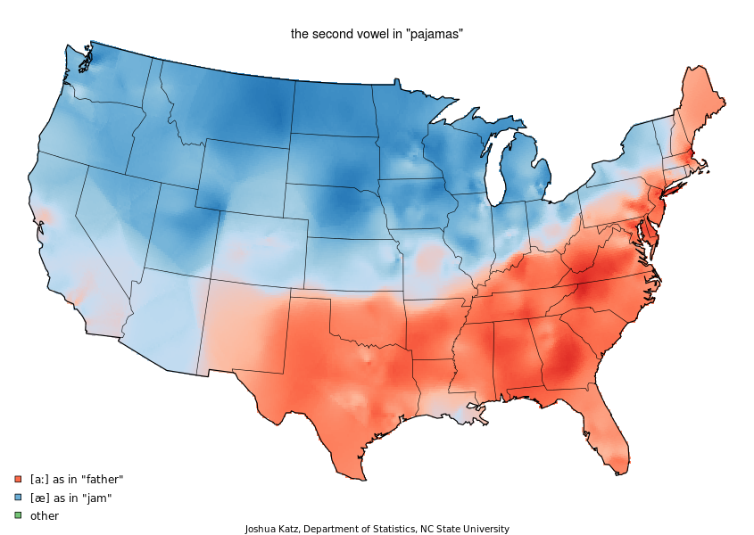

Slide 13
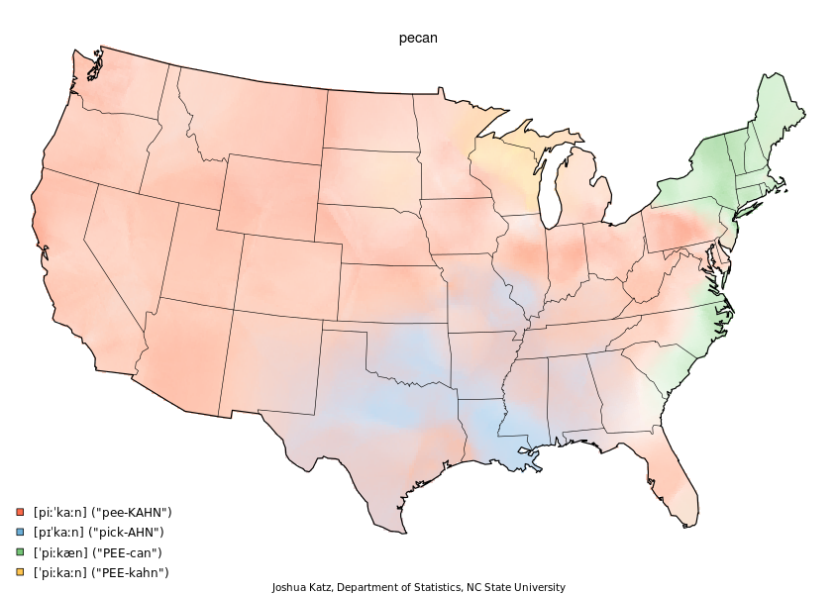

Slide 14
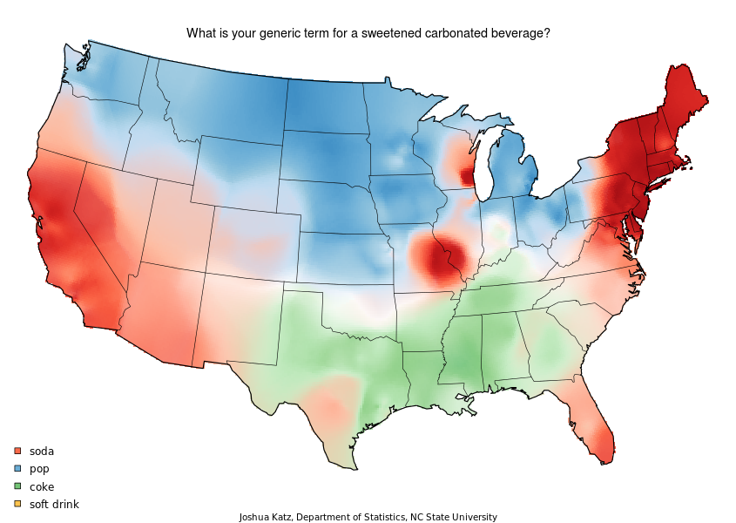

Slide 15
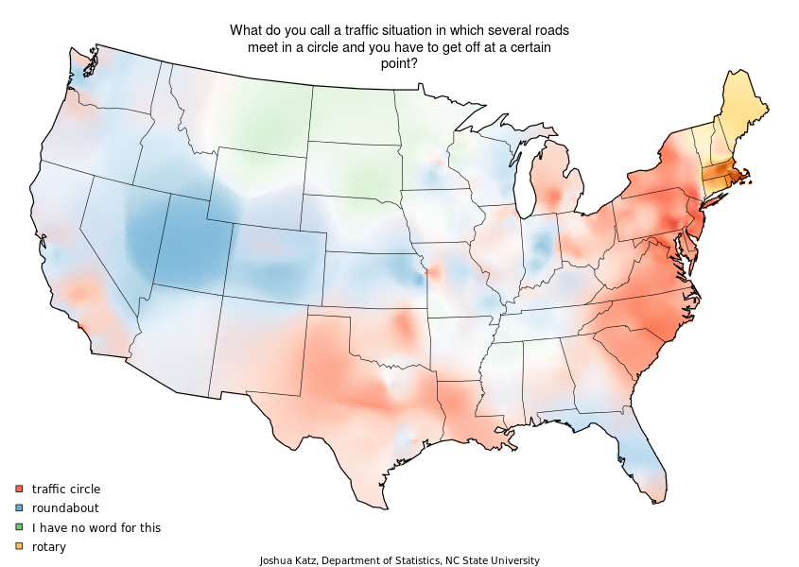

Slide 16
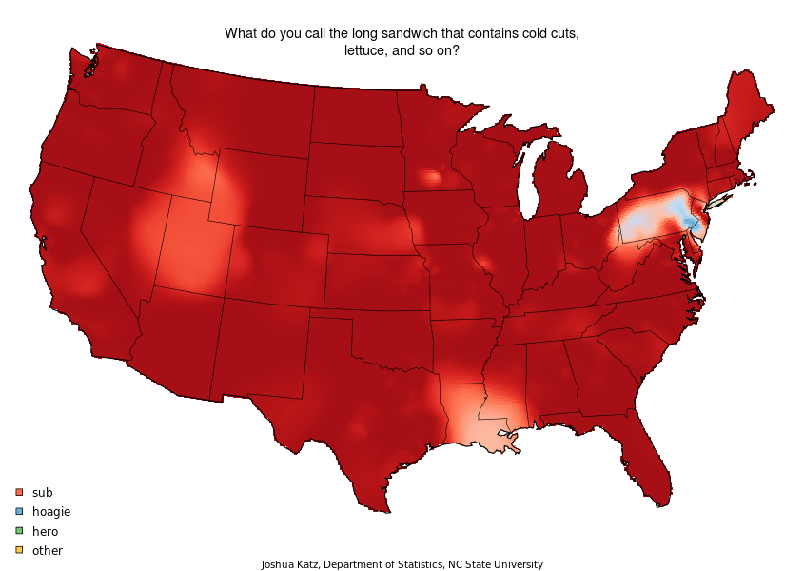

Slide 17
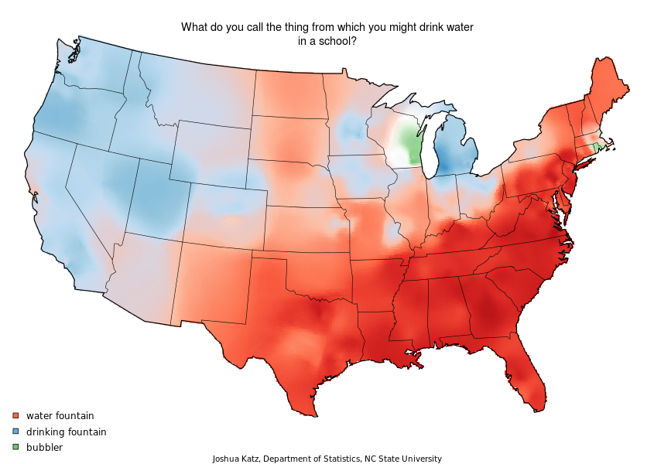

Slide 19
Languages
Top languages spoken in the world today (by native speakers):
Mandarin (955 million)
Spanish (405 million)
English (360 million)
Hindi (310 million)
Arabic (295 million)
Portuguese (215 million)

Slide 20
Customs and Traditions
Customs and traditions are the rules of a culture which govern behavior.
Eating with a fork or with chopsticks.
Sleep on a bed or in a hammock.
Greet others with a handshake or a bow.
Make eye contact with people in authority.
Tipping at a restaurant.
Walking down one side of a hallway.
Cultural rules vary in importance, and different social rules are enforced in different ways.
Social pressure can be used (ex: peer pressure)
Cultures can make laws to enforce some of the larger ideas of right and wrong.
Generally, you can very quickly identify customs and traditions when someone does something contrary.

Slide 21
Religion
Religions aim to answer the basic questions about the meaning of life.
The foundations of a religion are established in doctrines. A doctrine a belief or set of beliefs held and taught by a faith.
Due to differences in doctrines, religions can be divided into sub-groups called sects.
In order to spread the religion and convert non-believers to their faith, missionaries will travel from place to place preaching about their religion.
Typically, religions are categorized in two ways:
Polytheism is the belief in many gods or goddesses.
Examples include Ancient Greece, Rome, and Egypt as well as Hinduism.
Monotheism is the belief in one, all-powerful God.
Examples include Judaism, Christianity, and Islam.

Slide 22
Religion
Cosmology is the study of the origin, evolution, and eventual end of the universe.
Animism is the belief that non-human elements possess a spiritual essence.
Agnosticism is the belief that true claims about the existence or non-existence of God cannot be known or are unknowable. In other words, agnostics do not deny the existence of God – they simply do not believe or disbelieve in God.
Atheism is the rejection of the belief in the existence of deities. Conversely, theists believe in at least one deity.
Secularity is the state of being separate from religion. The word secular comes from the Latin saecularis which means “worldly.”
We commonly refer to this as the separation of church and state in the United States.

Slide 23
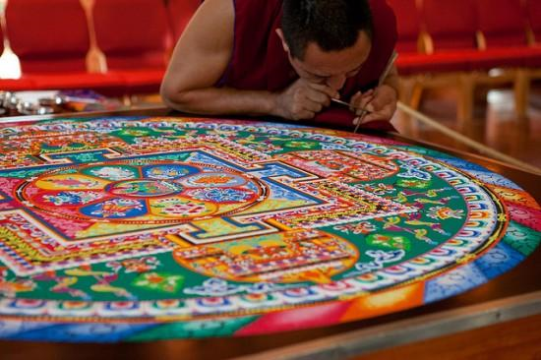
Arts and Literature
The arts and pieces of literature are the byproducts of human creativity.
Many early forms of art and literature were heavily influenced by religion.
Arts and literature can help to pass on the cultural values and basic beliefs of a society.
Examples can include music, stories, and folk tales.

Slide 24
Forms of Government
People form governments to provide for their common needs, keep order within society, and protects their society from outside threats.
In order to finance the functioning of government, taxes are usually levied against its population.
There are five major types of government:
Democracy
Republic
Dictatorship
Theocracy
Monarchy

Slide 25
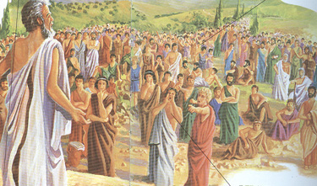
Democracies
In a democracy, the people hold supreme power and the government acts by consent.

Slide 26
Republic
In a republic, the people elect representatives to serve them in the government.

Slide 27
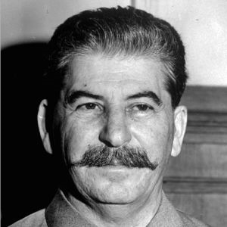
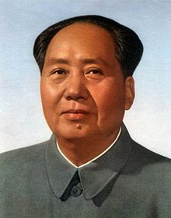
Dictatorships
In a dictatorship, a ruler and/or group holds power by force usually relying on military support for power.

Slide 28
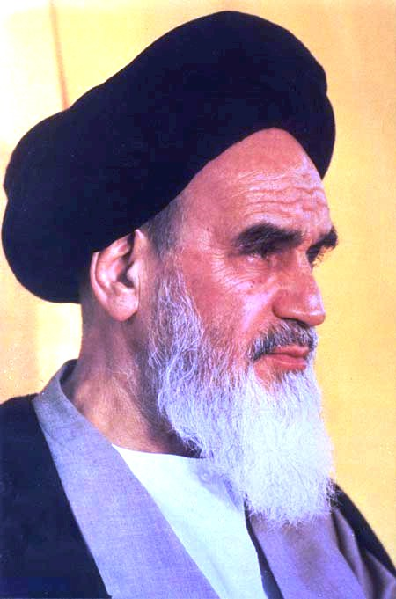
Theocracy
A theocracy is a type of government led by religious leaders.

Slide 29
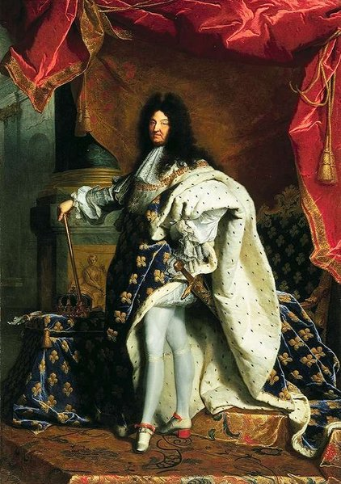
Monarchy
In a monarchy, kings and queens rule. These monarchs will usually claim rule by divine right and are granted their position based on inherence.

Slide 30
Economic Systems
The purpose of an economy is to meet unlimited needs and wants with limited resources.
At an economic system’s core is the need to provide food, water, and shelter to its people.
There are four main types of economies:
Traditional
Market
Command
Mixed

Slide 31
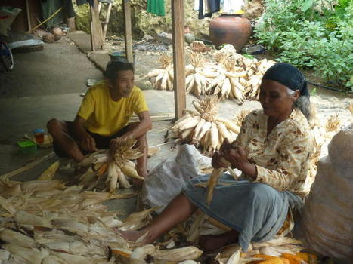
Traditional Economies
In a traditional economy, people produce most of what they need by themselves.
Activities in a traditional economy include hunting, gathering, farming, herding cattle, and/or making their own clothes/tools.

Slide 32
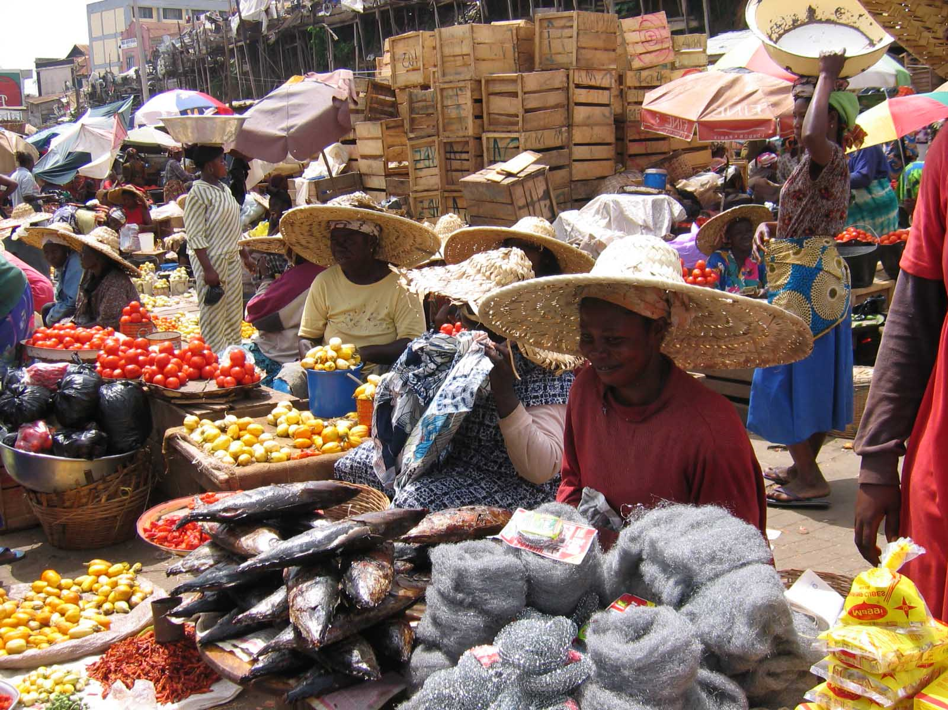
Market Economies
In a market economy, people buy and sell goods and services.
Usually there is no government interference.

Slide 33
Command Economies
In a command economy, the government controls what/how goods are produced and what they cost.
Individuals in an command economy have little economic power.
Black markets frequently appear in command economies. These markets provide illegal goods or services which the government has banished (often at inflated prices.)

Slide 34
Mixed Economies
In a mixed economy, individuals make some economic decisions and the government makes others.
Government involvement in the marketplace often takes the form of regulations, rules or laws designed to govern conduct.

Slide 35
Economic Philosophies Regarding Markets
Socialism (L) and Capitalism (R)
Both are ideals, frequently not purely achieved.
Socialism is an economic system in which the society holds control over the means of production and the management of the economy.
Capitalism is an economic system in which trade, industry, and the means of production are largely or entirely privately owned and operated for profit.
Under capitalism, market forces determine the supply and demand of goods and services.

